Slide 1
Ryan’s part

Slide 2
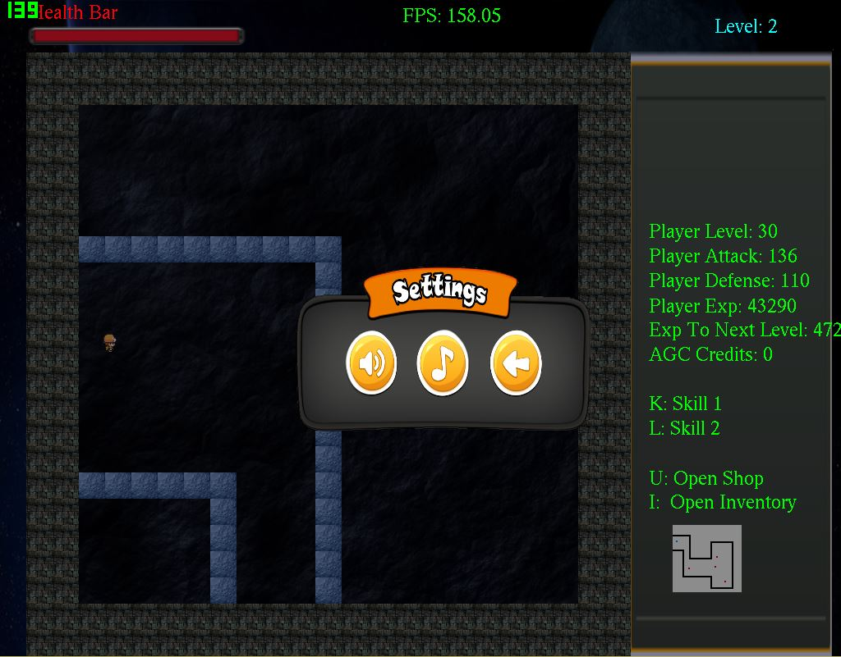
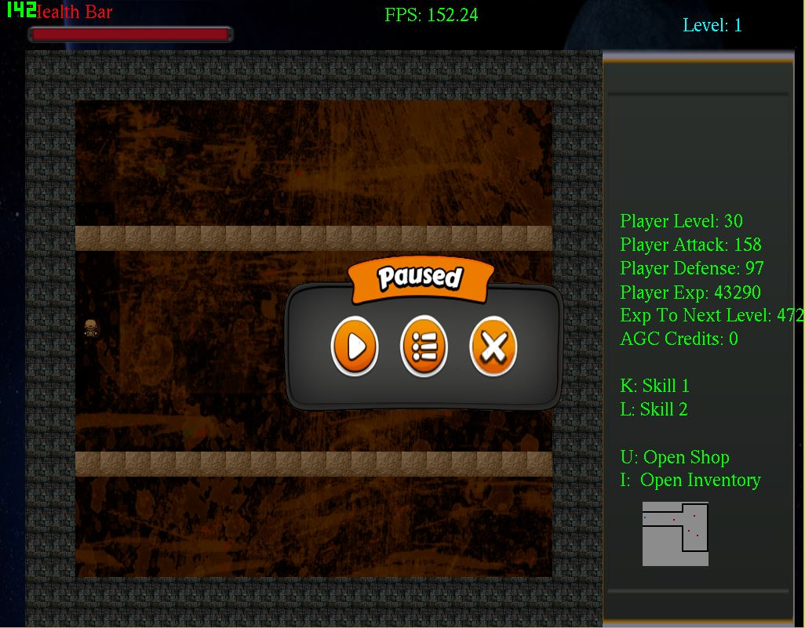
User Interface
Menu bars
Pause
Settings

Slide 3
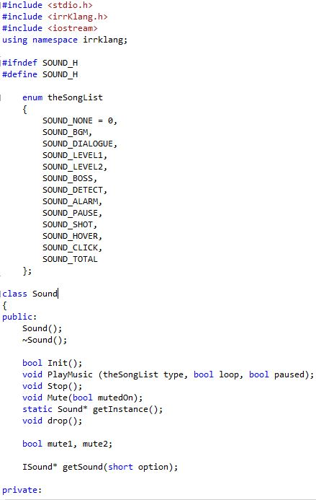
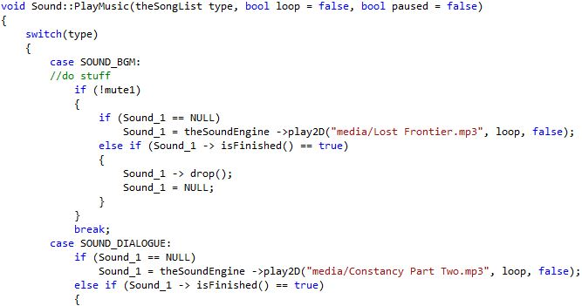
Sound
Sound effects
Music
Menu click sounds

Slide 4
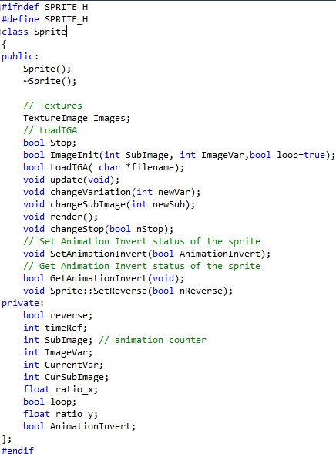
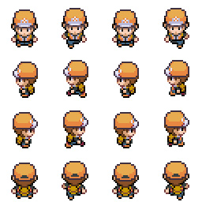

Sprites
Dynamic class
Takes in any forms of .tga images
Reusable

Slide 5
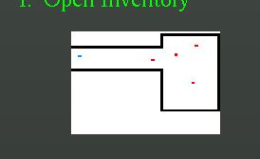
Minimap
Downscaled size of the original level
Shows region with objects close by
Moves with the player

